Slide 1
Chapter 9
Chemical Quantities

Slide 2
Information Given by Chemical Equations
These chemical equations tell us the identities (formulas) of the reactants and products and also show how much of each reactant and product participates in the reaction.
The numbers (coefficients) in the balanced chemical equation enable us to determine just how much product we can get from a given quantity of reactants.
The coefficients in a balanced equation give us the relative numbers of molecules.
  That is, we are interested in the ratio of the coefficients, not individual coefficients.

Slide 3
Methanol Production
Balanced: CO(g) + 2H₂(g) → CH₃OH(l)
Table 9.1 Information Conveyed by the Balanced Equation for the Production of Methanol
CO(g) | + | 2H₂(g) | → | CH₃OH(l)
1 molecule CO | + | 2 molecules H₂ | → | 1 molecule CH₃OH
1 dozen CO molecules | + | 2 dozen H₂ molecules | → | 1 dozen CH₃OH molecules
6.022 × 10²³ CO molecules | + | 2(6.022 × 10²³) H₂ molecules | → | 6.022 × 10²³ CH₃OH molecules
1 mol CO molecules | + | 2 mol H₂ molecules | → | 1 mol CH₃OH molecules

Slide 4
Chemical Equation Practice
Given the following equation: 2Al₂O₃ → 4Al + 3O₂
How many molecules of oxygen can be formed from 4 molecules of Al₂O₃?
If 8 atoms of Al are produced, how many molecules of oxygen will also be produced?

Slide 5
Using Balanced Equations
We can use an equation to predict the moles of products that a given number of moles of reactants will yield.
For example, consider the decomposition of water to give hydrogen and oxygen, which is represented by the following balanced equation:
2H₂O(l) → 2H₂(g) + O₂(g)
This equation tells us that 2 moles of H₂O yields 2 moles of H₂ and 1 mole of O₂.

Slide 6
Mole Ratios
2H₂O(l) → 2H₂(g) + O₂(g)
We can obtain the following mole ratios from this balanced equation:
2 mol H₂O = 2 mol H₂
2 mol H₂O = 1 mol O₂
2 mol H₂ = 1 mol O₂

Slide 7
Mole Ratios Practice
Given the following equation: N₂ + 3H₂ → 2NH₃
Write each of the mole ratios.

Slide 8
Mole Ratios Practice 2
Given the following equation: N₂ + O₂ → 2NO
Write each of the mole ratios.

Slide 9
LA problem - 1
Ethane (C₂H₆) burns when ignited in the presence of oxygen.

Slide 10
Mole–Mole Conversions Practice
Given the following equation: Fe₂O₃ + 3CO → 2Fe + 3CO₂
How many moles of Fe can be produced from 17.5 mol of CO?

Slide 11
Mole–Mole Conversions Practice 2
Given the following equation: 2C₂H₆ + 7O₂ → 4CO₂ + 6H₂O
How many moles of O₂ are needed to react with 0.987 mol of C₂H₆?

Slide 12
Mole–Mole Conversions Practice 3
Ammonia reacts with sodium hypochlorite to produce sodium hydroxide and chloramine gas (which is a very toxic gas).
1.32 moles of ammonia will produce how much of the gas?

Slide 13
Converting Moles to Mass
We can use the balanced equation for a reaction to calculate the numbers of moles of reactants and products for a particular case.
  However, moles represent numbers of molecules, and we cannot count molecules directly.
  In chemistry we count by weighing.
  We can use the molar mass to convert between moles and mass.

Slide 14
Steps for Calculating the Masses of Reactants and Products in Chemical Reactions
Balance the equation for the reaction.
Convert the masses of reactants or products to moles.
Use the balanced equation to set up the appropriate mole ratio(s).
Use the mole ratio(s) to calculate the number of moles of the desired reactant or product.
Convert from moles back to masses.

Slide 15
Stoichiometry
The process of using a chemical equation to calculate the relative masses of reactants and products involved in a reaction is called stoichiometry.
Chemists say that the balanced equation for a chemical reaction describes the stoichiometry of the reaction.

Slide 16
Think, Pair, Share Activity – Unit 9.3
Turn to your neighbor and explain:
  Why is it important to balance an equation before using it in a stoichiometry problem?

Slide 17
Stoichiometry Practice
Given the following equation: 2SO₂ + O₂ → 2SO₃
How many grams of SO₃ can be produced from 2.33 mol of O₂?

Slide 18
Stoichiometry Practice 2
Given the following equation: H₂SO₄ + 2KOH → K₂SO₄ + 2H₂O
How many moles of H₂SO₄ are needed to react with 19.9 g of KOH?

Slide 19
Stoichiometry Practice 3
Given the following equation: 4NH₃ + 5O₂ → 4NO + 6H₂O
How many grams of NH₃ are needed to produce 54.7 g of NO?

Slide 20
Stoichiometry Practice 4
Given the following equation: CuSO₄ + Fe → FeSO₄ + Cu
How many grams of CuSO₄ are needed to react with 244 g of Fe?

Slide 21
Limiting Reactants
In a chemical reaction, one reactant is generally used up first.
  This reactant is known as the limiting reactant or limiting reagent.
  The limiting reactant controls how much product is formed.
To determine how much product can be formed from a given mixture of reactants, we have to look for the reactant that is limiting—the one that runs out first and thus limits the amount of product that can form.

Slide 22
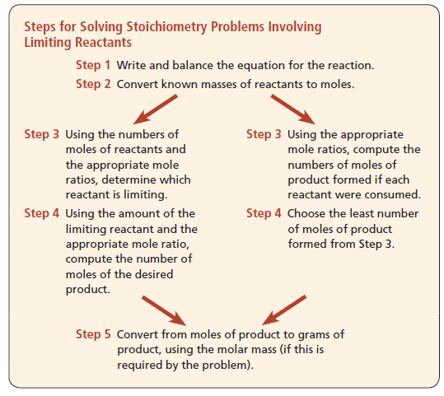
Steps for Solving Stoichiometry Problems Involving Limiting Reactants

Slide 23
Limiting Reactants Practice
Given the following equation: 3Mg + N₂ → Mg₃N₂
If 4.75 mol Mg reacts with 2.11 mol N₂, what is the limiting reactant?

Slide 24
Limiting Reactants Practice 2
Given the following equation: 4Al + 3O₂ → 2Al₂O₃
If 17.9 g Al reacts with 64 g O₂, what is the limiting reactant?

Slide 25
Theoretical Yield
In doing our previous calculations, we used the fact that the amount of product is controlled by the limiting reactant.
Products stop forming when one reactant runs out.
The amount of product calculated in this way is called the theoretical yield of that product.
  It is the amount of product predicted from the amounts of reactants used.

Slide 26
Theoretical Yield Practice
Given the following equation: Pb(NO₃)₂ + 2NaCl → PbCl₂ + 2NaNO₃
If 237 g NaCl reacts with excess Pb(NO₃)₂, what is the theoretical yield of PbCl₂?

Slide 27
Theoretical Yield Practice 2
Given the following equation: 2Na + Cl₂ → 2NaCl
If 68 g Na reacts with 97 g Cl₂, what is the theoretical yield of NaCl?

Slide 28
Actual Yield
The theoretical yield is the maximum amount of product that can be produced from the quantities of reactants used.
Actually, however, the amount of product predicted (the theoretical yield) is seldom obtained.
  One reason for this is the presence of side reactions (other reactions that consume one or more of the reactants or products).
The amount of product actually produced is known as the actual yield.

Slide 29
Think, Pair, Share Activity – Unit 9.6
Turn to your neighbor and explain:
  Is it possible to obtain an actual yield that is higher than the theoretical yield? Why or why not?

Slide 30
Percent Yield
The actual yield of product, which is the amount of product actually obtained, is often compared to the theoretical yield.
This comparison, usually expressed as a percentage, is called the percent yield.
Percent yield is important as an indicator of the efficiency of a particular reaction.

Slide 31
Percent Yield Practice
Given the following equation: H₂ + I₂ → 2HI
If 69.1 g H₂ reacts with excess I₂ and 134 g HI are actually produced, what is the percent yield?

Slide 32
Percent Yield Practice 2
Given the following equation: 2KClO₃ → 2KCl + 3O₂
If 191 g KClO₃ decomposes and 89.9 g KCl are actually produced, what is the percent yield?

